Slide 1

RESURRECTION (FELTÁMADÁS)
Zene: Mascagni - Parasztbecsület - Húsvéti kórus
Lehotka Gábor, Tokody Ilona
A Magyar Állami Operaház Ének- és Zenekara Vezényel: Nagy Ferenc

Slide 2
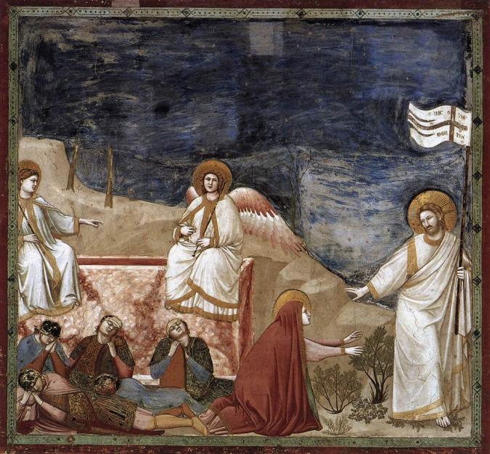
GIOTTO, DI BONDONE: RESURRECTION, 1304-06
Fresco, 200 x 185 cm, Cappella Scrovegni (Arena Chapel), Padua

Slide 3
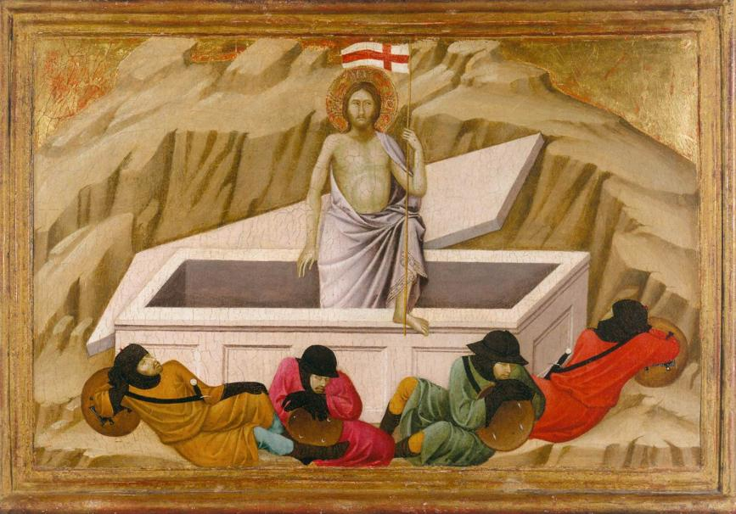
UGOLINO, DI NERIO: THE RESURRECTION, 1325-28
Egg tempera on wood, 42 x 58 cm, National Gallery, London

Slide 4
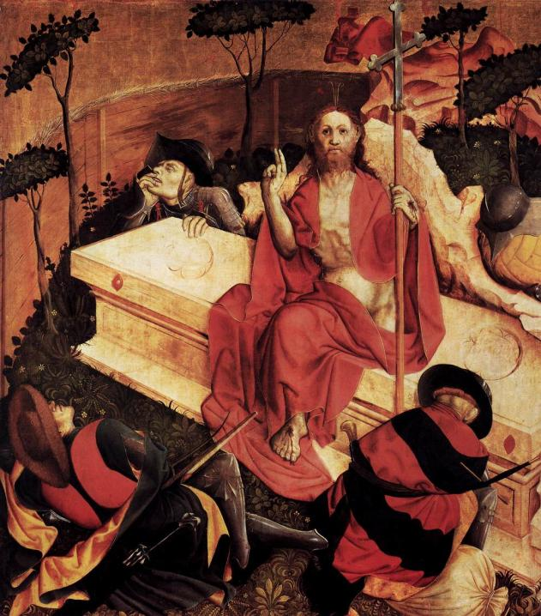
MULTSCHER, HANS
RESURRECTION
1437
Panel, 148 x 140 cm
Staatliche Museen, Berlin

Slide 5
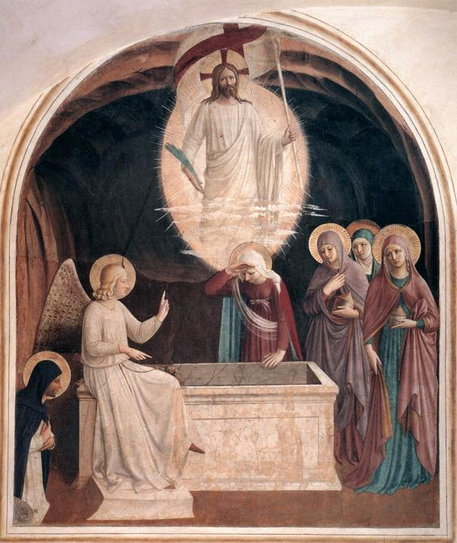
ANGELICO, FRA
RESURRECTION OF CHRIST AND WOMEN AT THE TOMB
1440-42
Fresco, 181 x 151 cm
Convento di San Marco, Florence

Slide 6
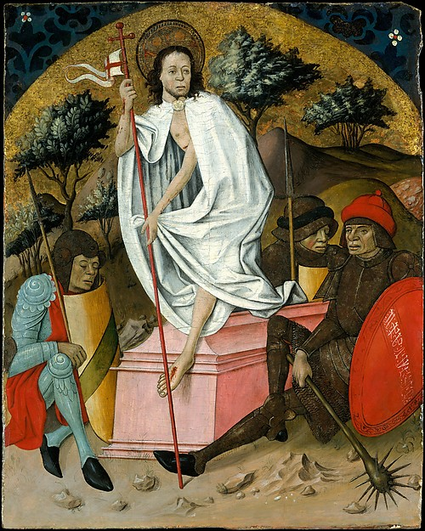
SPANISH (ARAGONESE) PAINTER
(mid-15th century)
Oil and silver on wood, gold ground
78,7 x 63,2 cm
Metropolitan Art Museum New York

Slide 7
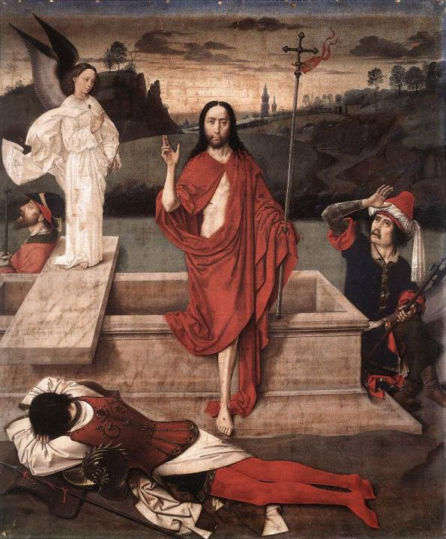
BOUTS, DIERIC THE ELDER
RESURRECTION
1450-60
Tempera on canvas
89 x 72,5 cm
Norton Simon Museum of Art, Pasadena

Slide 8
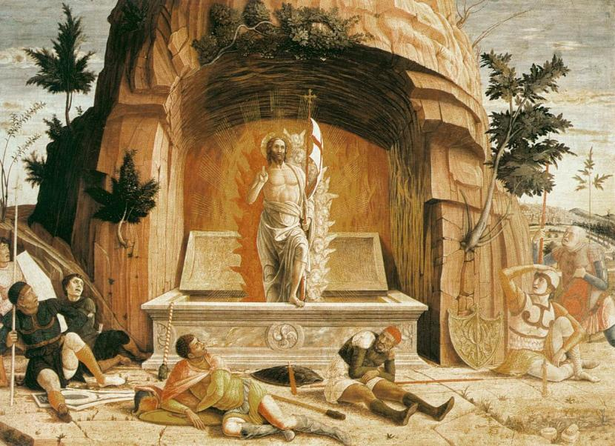
MANTEGNA, ANDREA: RESURRECTION, 1457-59
Tempera on panel, 71 x 94 cm, Musée des Beaux-Arts, Tours

Slide 9
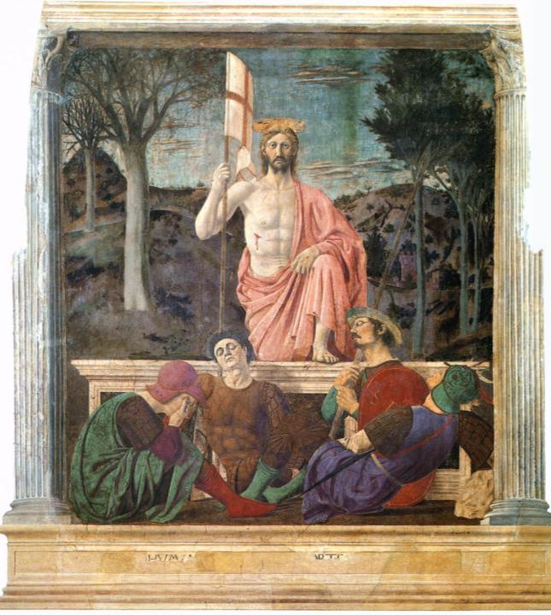
PIERO DELLA FRANCESCA
RESURRECTION
1463-65
Mural in fresco and tempera
225 x 200 cm
Pinacoteca Comunale, Sansepolcro

Slide 10
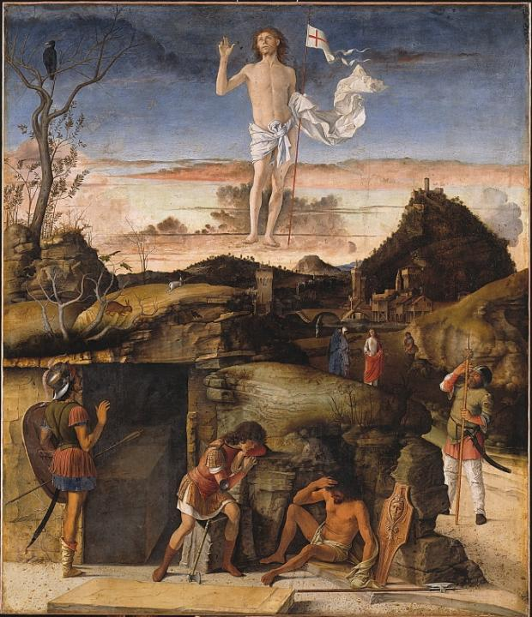
BELLINI, GIOVANNI
RESURRECTION OF CHRIST
1475-79
Oil on panel transferred to canvas
148 x 128 cm
Staatliche Museen Berlin

Slide 11
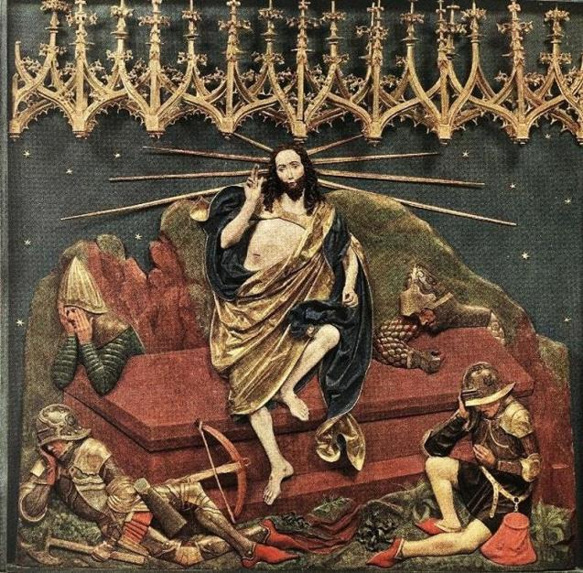
STOSS, VEIT: RESURRECTION, 1477 – 1489
Altarpiece Church of Our Lady, Cracow, Poland

Slide 12
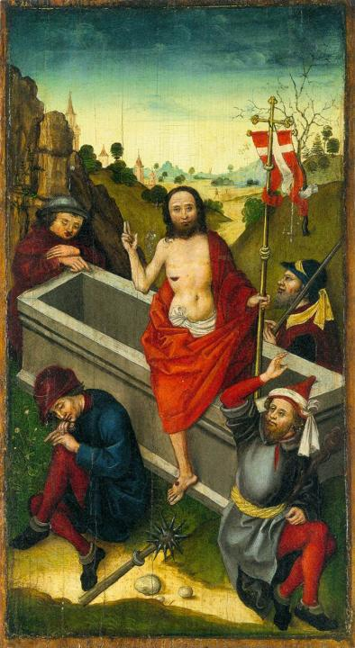
SCHONGAUER, LUDWIG:
THE RESURRECTION
1480-85
Oil on fir panel
37 x 20 cm
Metropolitan Museum of Art
New York

Slide 13
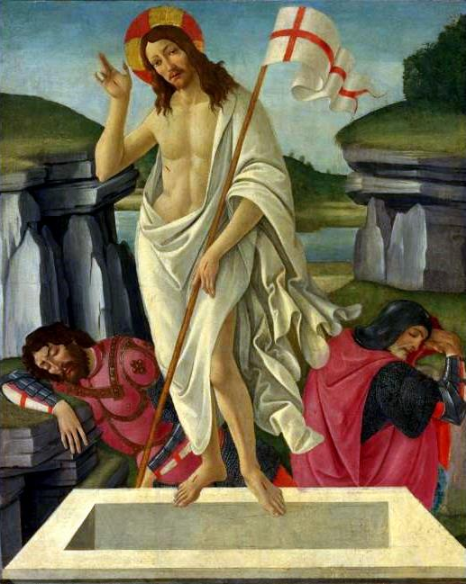
BOTICELLI, SANDRO
RESURRECTION
1490
tempera on canvas
52 x 41, 3/4 in formerly Beaverbrook Gallery Canada

Slide 14
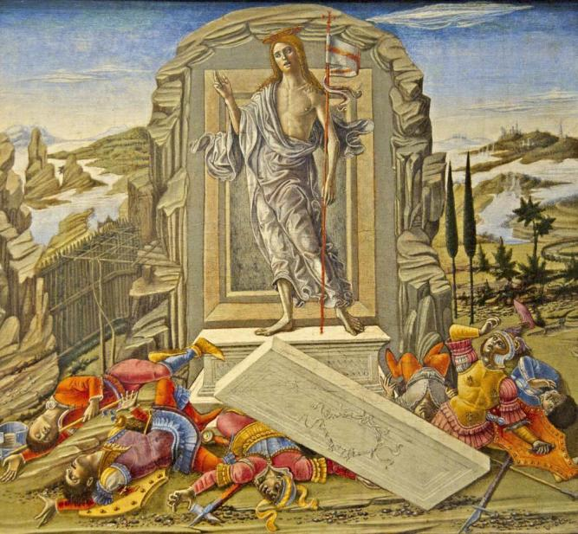
BENVENUTO, DI GIOVANNI: THE RESURRECTION, c. 1491,
Tempera on panel, 42 x 47 cm, National Gallery of Art, Washington

Slide 15
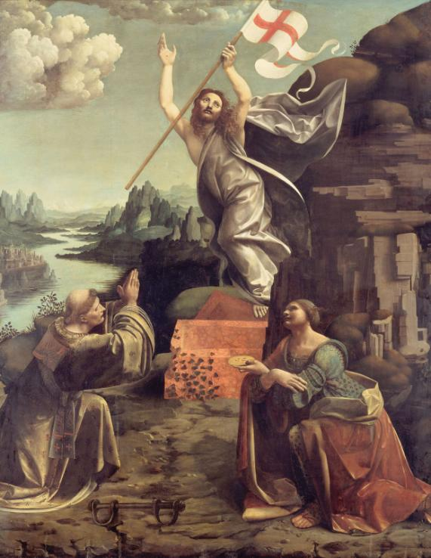
OGGIONO, MARCO D’
RESURRECTION OF CHRIST WITH STS LEONARDO AND LUCY
1491-94
Oil on panel
Staatliche Museen, Berlin

Slide 16
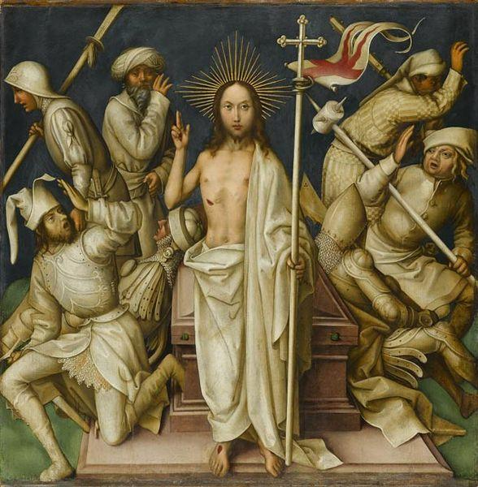
HOLBEIN, HANS THE ELDER: RESURRECTION, series in his Grey Passion
1494 and 1500, Oil and tempera on wood, 89 x 87,4 cm
Stuttgart State Art Gallery in, Germany

Slide 17
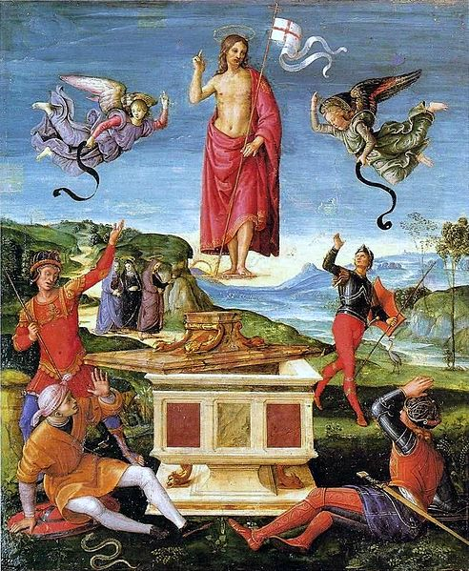
RAFFAELLO, SANTI
THE RESURRECTION OF JESUS CHRIST
1499 until 1502
Oil on panel
52 × 44 cm
Museu de Arte de São Paulo

Slide 18
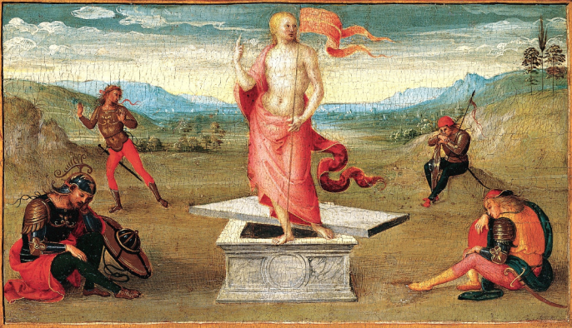
PERUGINO, PIETRO : RESURRECTION OF CHRIST 1502-1506
tempera on wood, 27 x 45,7 cm Metropolitan Museum of Art
New York

Slide 19
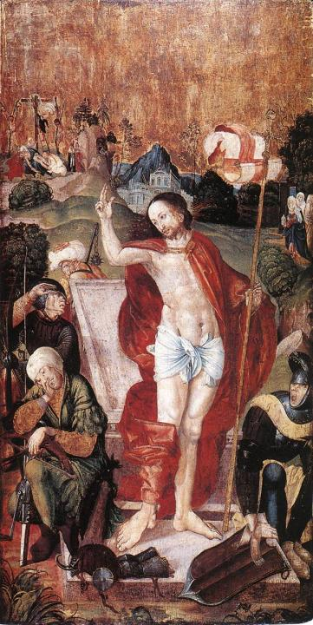
MASTER M S
THE RESURRECTION
1506
Tempera on limewood
158 x 80,5 cm
Christian Museum, Esztergom

Slide 20
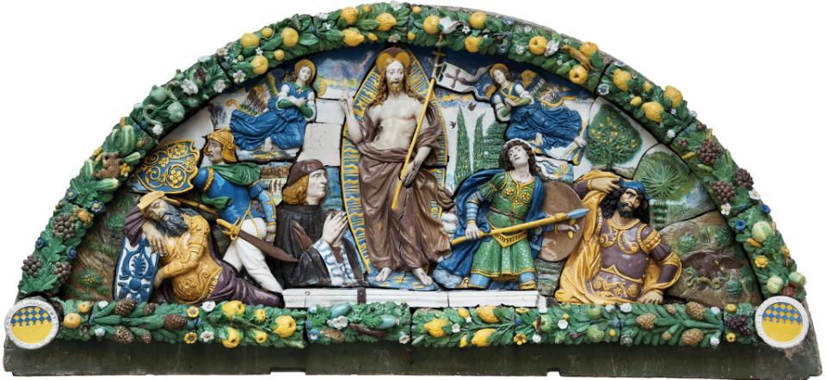
ROBBIA’S,GIOVANNI DELLA : RESURRECTION OF CHRIST,
c. 1500-1520, Glazed terracotta, 174.6 x 364.5 x 33 cm
Brooklyn Museum of Art, New York, USA

Slide 21
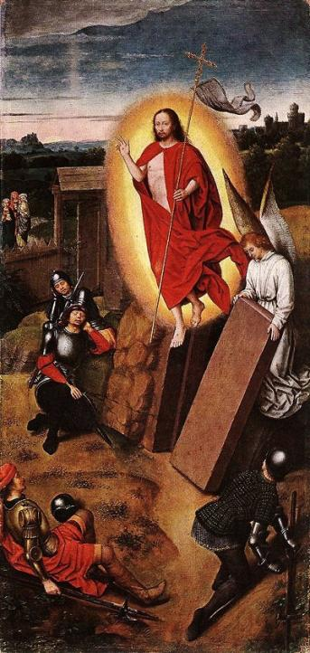
MEMLING, HANS
RESURRECTION
-
Oil on oak, 58 x 28,2 cm
Szépmûvészeti Múzeum, Budapest

Slide 22
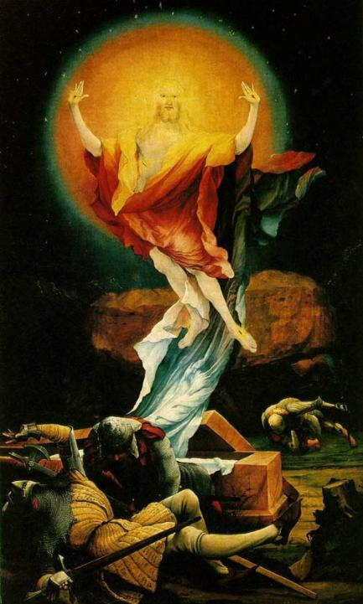
GRÜNEWALD, MATTHIAS
THE RESURRECTION
(part of the Isenheim Altarpiece),
c. 1515
106 x 60 1/4 in
Oil on wood
Musée d'Unterlinden, Colmar

Slide 23
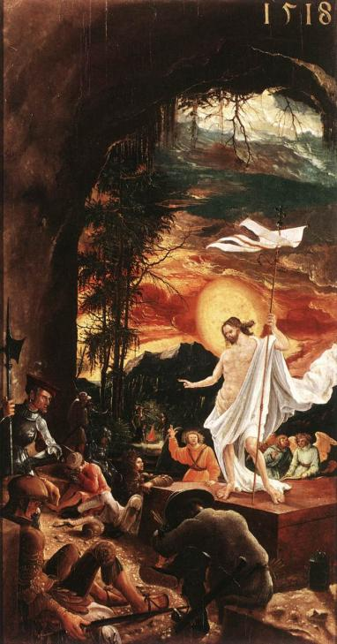
ALTDORFER, ALBRECHT
THE RESURRECTION OF CHRIST
c. 1516
Oil on wood, 71 x 37 cm
Kunsthistorisches Museum, Vienna

Slide 24
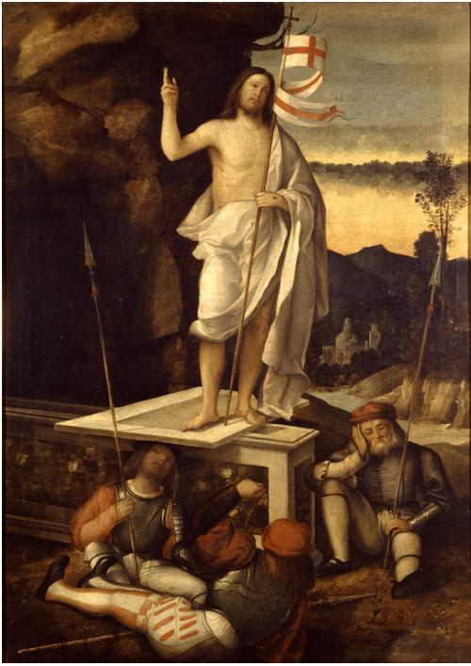
BASAITI, MARCO
RESURRECTION OF CHRIST
1520
Oil on canvas
140 x 100 cm
Accademia Carrara, Bergamo

Slide 25
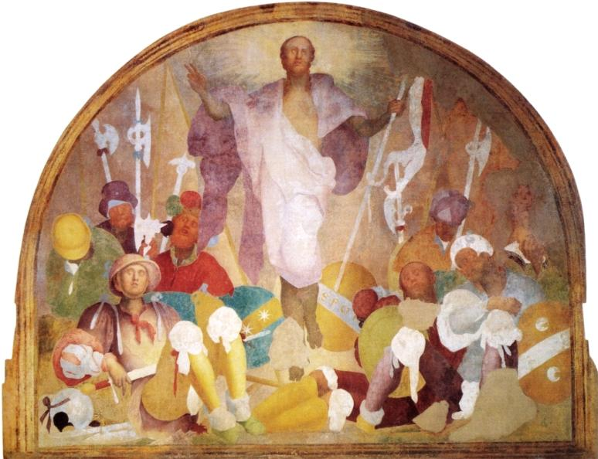
PONTORMO, JACOPO: RESURRECTION, 1523 - 1525
Fresco, 232 x 291 cm, The Certosa del Galluzzo, Florence

Slide 26
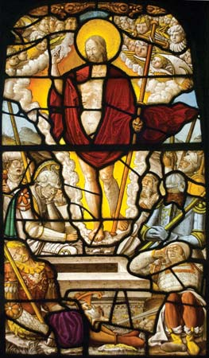
REMISCH, GERHARD
THE RESURRECTION
1540–42
clear and coloured glass with paint and silver stain, made in the workshop of
The Victoria and Albert Museum, London

Slide 27
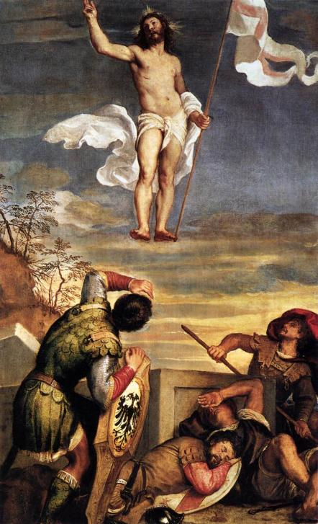
TIZIANO, VECELLIO
THE RESURRECTION
1542-44
Oil on canvas
163 x 104 cm
Palazzo Ducale, Urbino

Slide 28
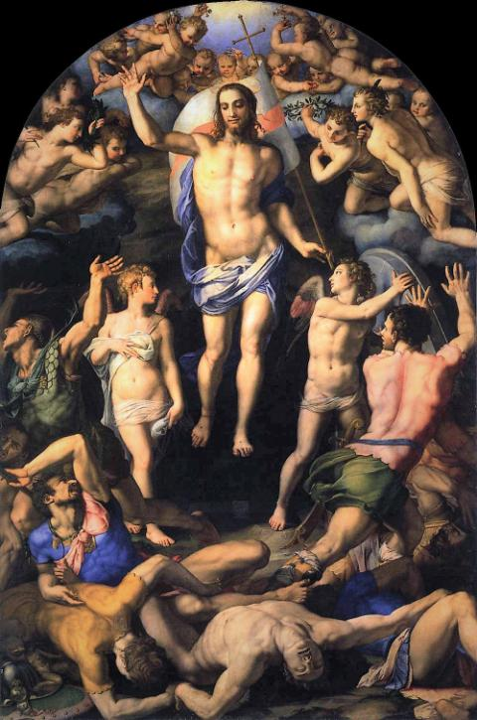
BRONZINO, AGNOLO
RESURRECTION
1552
Oil on canvas
Santissima Annunziata, Florence

Slide 29
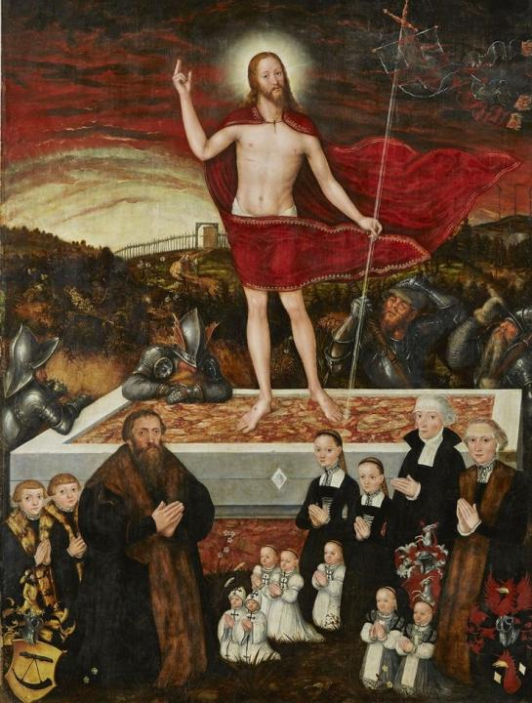
CRANACH, LUCAS THE YOUNGER
THE RESURRECTION OF CHRIST
1554
Painting on lime wood
163 x 124 cm
Museum der bildenden Künste, Leipzig

Slide 30
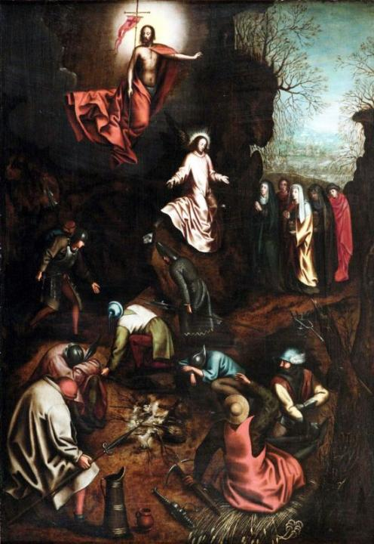
BRUEGEL, PIETER THE ELDER
THE RESURRECTION OF CHRIST
1563
107×73.8 cm
Privat collection

Slide 31
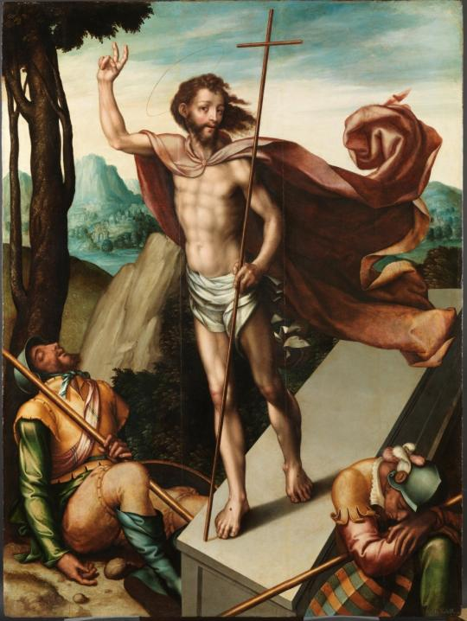
MORALES, LUIS DE
THE RESURRECTION
1566
oil
167,7 - 125,4 cm
Museo del Prado

Slide 32
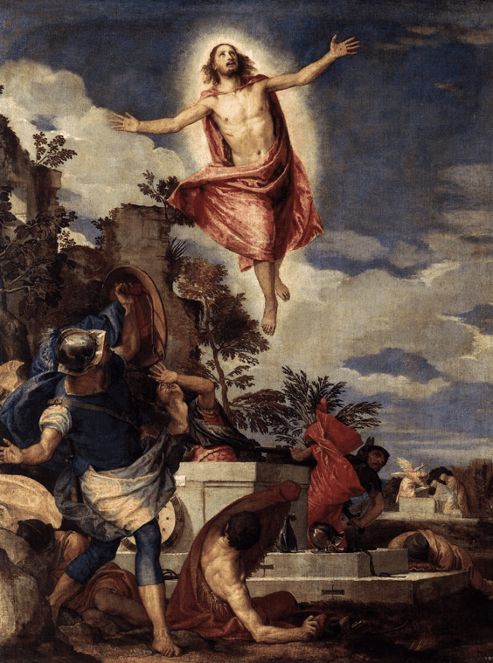
VERONESE, PAOLO
THE RESURRECTION OF CHRIST
c. 1570
Oil on canvas
136 x 104 cm
Gemäldegalerie, Dresden

Slide 33
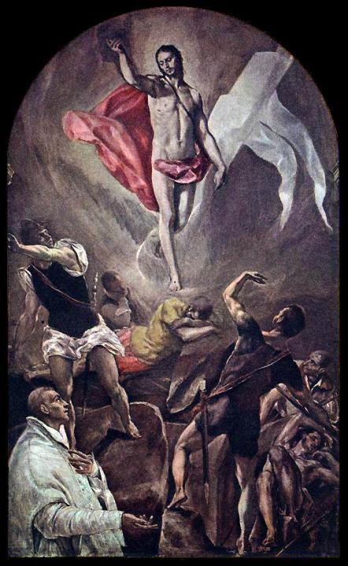
GRECO, EL
THE RESURRECTION
1577-79
Oil on canvas
210 x 128 cm
Church of Santo Domingo el Antiguo, Toledo

Slide 34
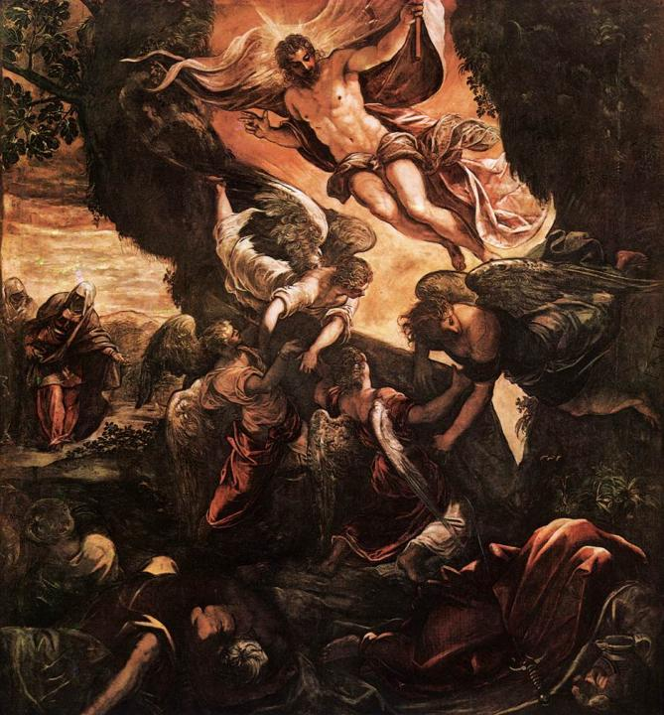
TINTORETTO
THE RESURRECTION OF CHRIST
1579-81
Oil on canvas
529 x 485 cm
Scuola Grande di San Rocco
Venice

Slide 35
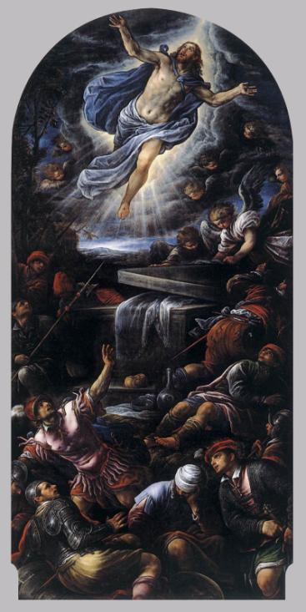
BASSANO, FRANCESCO
RESURRECTION OF CHRIST
1584-88
Oil on canvas
Santissimo Redentore, Venice

Slide 36
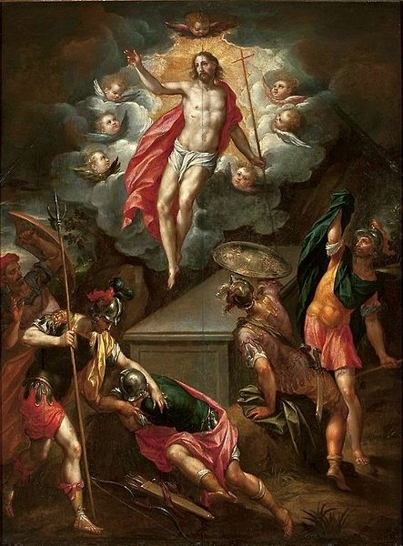
CLERCK, HENDRICK DE
THE RESURRECTION OF JESUS CHRIST
fourth quarter of 16th century oil on panel
70 × 53 cm
National Museum, Warsaw

Slide 37
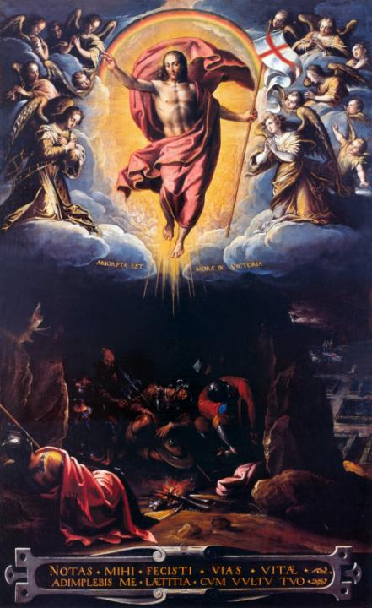
PASSIGNANO
THE RESURRECTION
1600-25
Oil on canvas
112 x 70 cm
Pinacoteca, Vatican

Slide 38
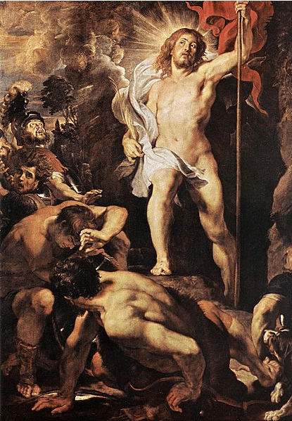
RUBENS, PETER PAUL
THE RESURRECTION OF CHRIST
(centre panel of triptych),
c.1611/12
oil on panel 54 x 38 cm
Onze-Lieve-Vrouwekathedrall
(Cathedral of Our Lady), Antwerp

Slide 39
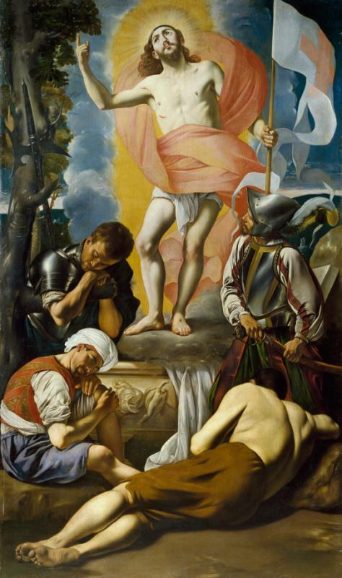
MAÍNO, JUAN BAUTISTA RESURRECTION OF CHRIST
1612 – 1614
Oil on canvas
295 x 174 cm
Museo del Prado, Madrid

Slide 40
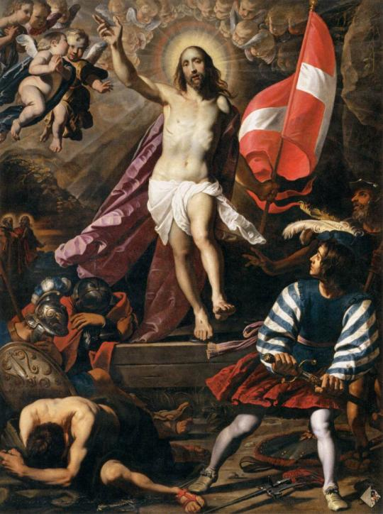
SEGHERS, GERARD
RESURRECTION OF CHRIST
c. 1620
Oil on canvas
324 x 240 cm
Musée du Louvre, Paris

Slide 41
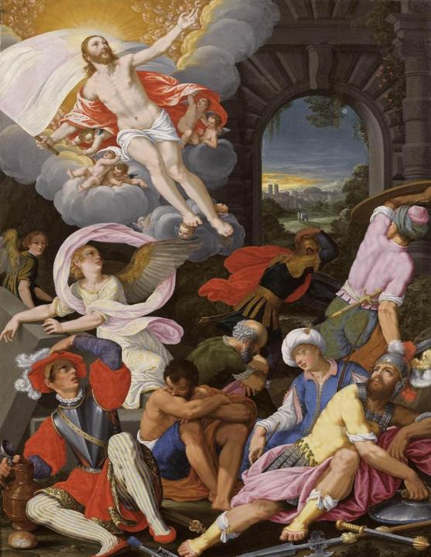
KÖNIG, JOHANN
THE RESURRECTION OF CHRIST
1622
Oil on copper, 61 x 46 cm
Private collection

Slide 42
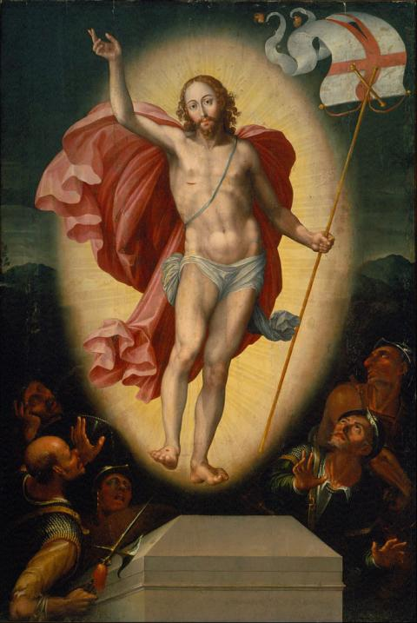
HERRERA, ALONSO LÓPEZ DE
THE RESURRECTION OF CHRIST
ca. 1625
oil on wood
2400 x 1,620 mm
Museo Nacional Mexico City

Slide 43
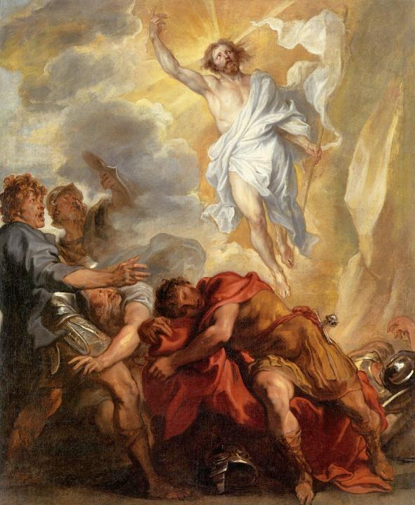
DYCK, SIR ANTHONY VAN
THE RESURRECTION OF CHRIST
1631
94.3 x 114 cm
Wadsworth Athaneum, Hartford, CT

Slide 44
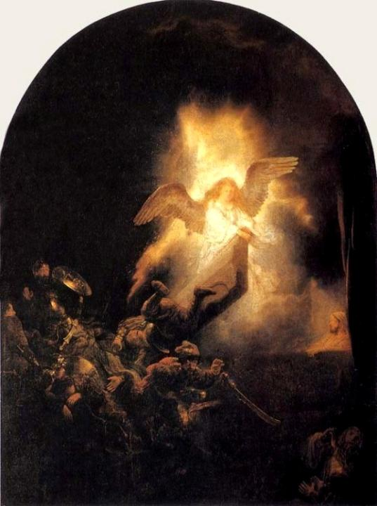
REMBRANDT HARMENSZOON VAN RIJN
THE RESURRECTION OF CHRIST
c. 1639
Oil on canvas
92 x 67 cm
Alte Pinakothek, Munich

Slide 45
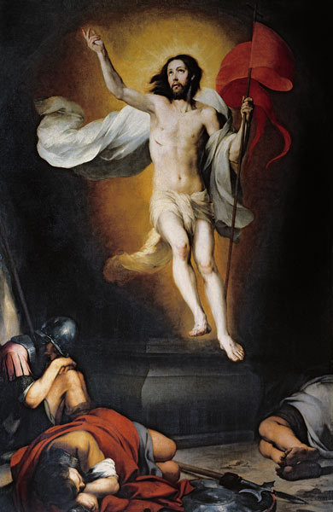
MURILLO
BARTOLOMÉ ESTEBAN PEREZ
THE RESURRECTION OF
1650-1660
Oil on canvas
243 x 164 cm
Real Academia de Bellas Artes de San Fernando, Madrid

Slide 46
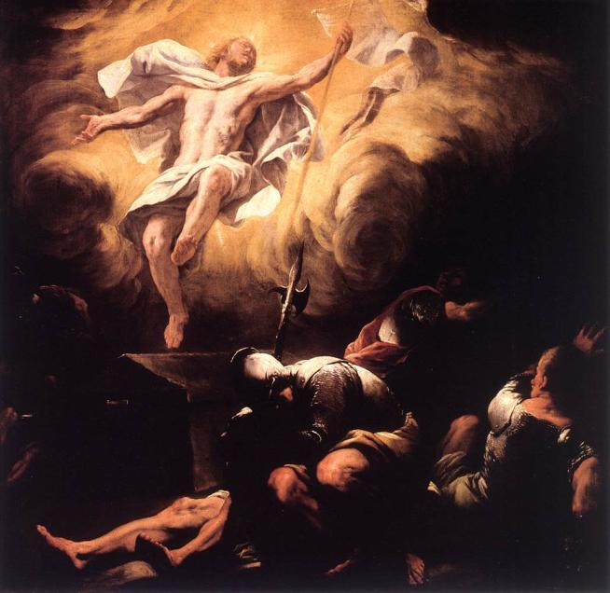
GIORDANO, LUCA
RESURRECTION
after 1665
Oil on canvas
114 x 116 cm
Residenzgalerie
Salzburg

Slide 47
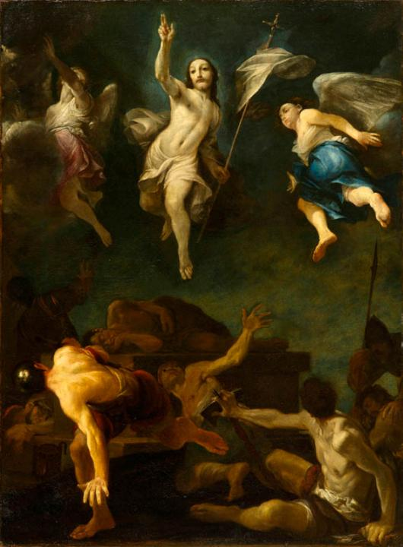
CRESPI, GIUSEPPE MARIA
THE RESURRECTION OF CHRIS
c. 1690
143,5 x 101,6 cm
Oil on canvas
North Carolina
Museum of Art

Slide 48
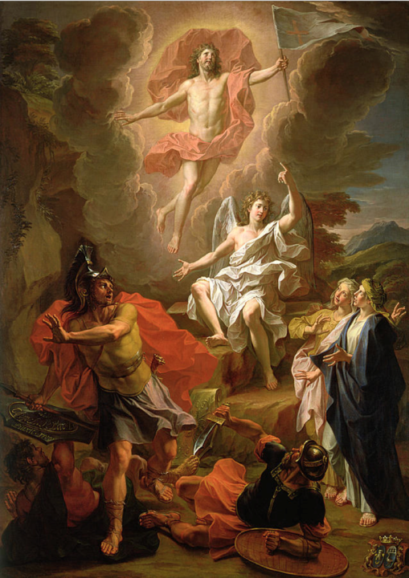
COYPEL, NOEL
(COYPEL LE POUSSIN)
THE RESURRECTION OF CHRIST
1700
oil on canvas
Musée des Beaux-Arts de Rouen

Slide 49
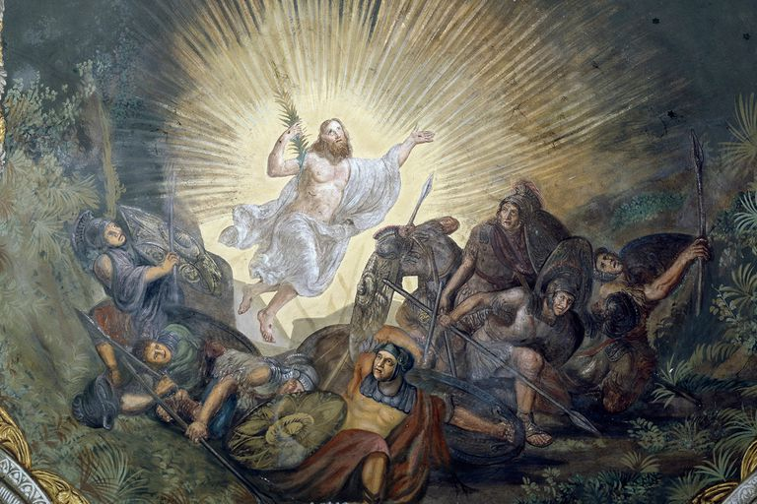
ADEMOLLO, LUIGI: RESURRECTION, 19th century, fresco at
St. John Baptist's Parish Church, Tuscany, Italy

Slide 50
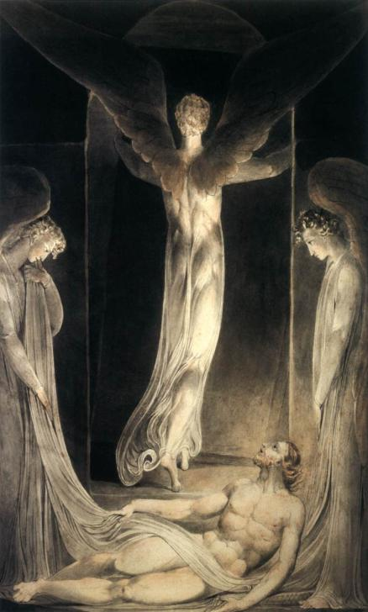
BLAKE, WILLIAM
THE RESURRECTION
The angel rolling away the stone from the sepulchre
c. 1805
Pen, ink, watercolour
412 x 300 mm
Victoria and Albert Museum, London

Slide 51
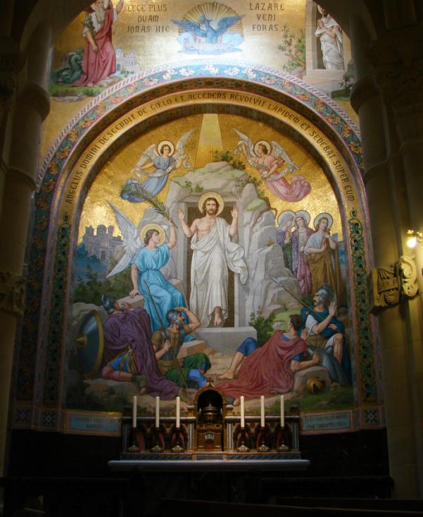
THE RESURRECTION
19 th century,
Mosaic
Rosary Basilica, Lourdes

Slide 52

VRUBEL, MIKHAIL ALEKSANDROVICH: RESURRECTION, 1887
pencil, w/c & gouache on paper, Museum of Russian Art, Kiev, Ukraine Bridgeman Images

Slide 53

TISSOT, JAMES
THE RESURRECTION
1886-1894
Opaque watercolor over graphite on gray wove paper,
32.5 x 21.1 cm
Brooklyn Museum

Slide 54

NOLDE, EMIL
RESURRECTION
1912
Oil on cardboard
100 X 86 cm
Nolde Stiftung Seebüll Deutschland -Neukirchen

Slide 55

MEDVECZKY JENŐ
KRISZTUS FELTÁMADÁSA
1941
Freskó
Plébániatemplom, Tát

Slide 56

CHAGALL, MARC
RESURRECTION
1937-1952,France
Oil, canvas
168 x 108 cm

Slide 57

MEIERE, HILDRETH: RESURRECTION 1951
mosaic, Chapel at the National Cathedral in Washington, D.C

Slide 58

DALÍ, SALVADOR
THE RESURRECTION
1979
Lithograph on Arches paper
58.42 x 40.64 cm

Slide 59

ARCABAS (JEAN-MARIE PIROT): RESURRECTION, 1999
St Paul de Meythet Church

